Slide 1

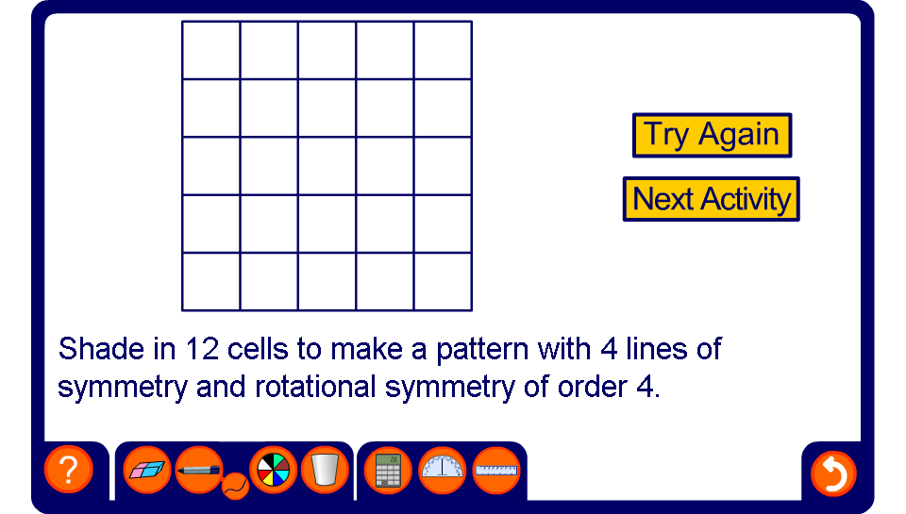


Reflection and rotational symmetry
Notes:
There may be several solutions for each one. Ask volunteer to show alternative patterns. Use the pen tool to draw on any lines of symmetry if needed.
Praise more imaginative patterns.

